Slide 1


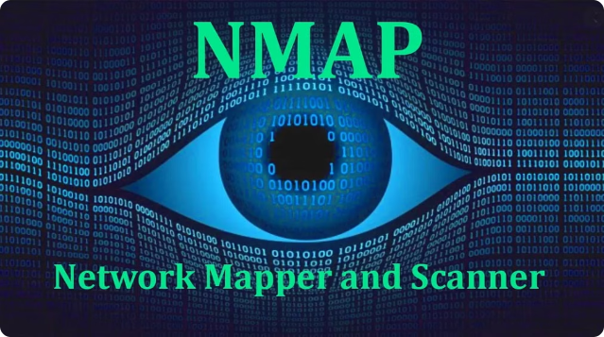
Comprehensive Networking Mapping with Nmap
This presentation explores a project that aims to simplify network scanning by leveraging the power of Nmap, a widely used network scanning tool. It presents a user-friendly interface that streamlines network mapping and vulnerability assessment tasks for network administrators and security professionals.

Slide 2

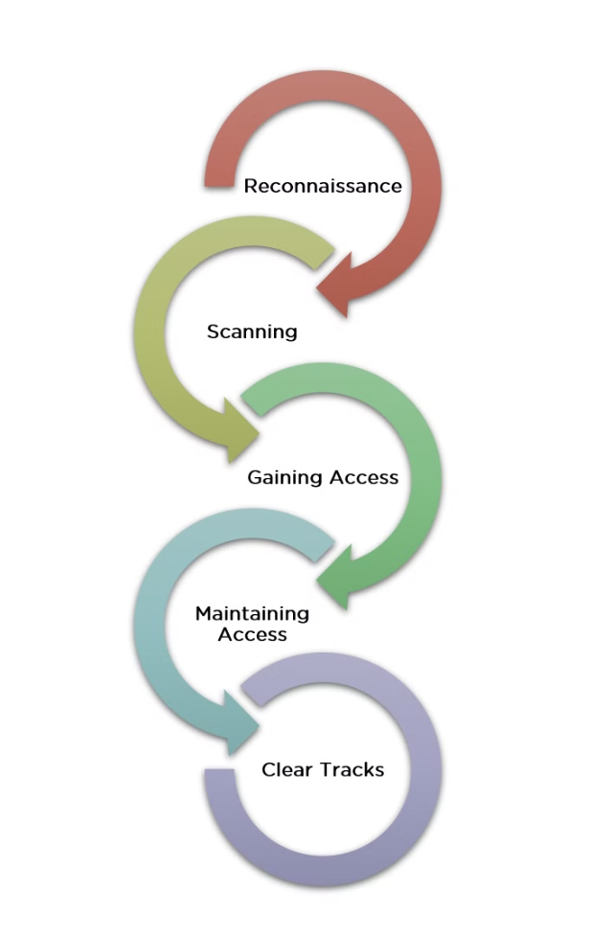
Problem Statement
1
Complexity of Existing Tools
Current network mapping solutions often require extensive configuration and have a steep learning curve, making them challenging for users with limited technical expertise.
2
Need for Improvement
There is a need for a more intuitive and user-friendly approach to network scanning that simplifies the process and enhances accessibility for a broader range of users.

Slide 3

Introduction
Project Overview
Benefits
The project leverages Nmap, a powerful network scanning tool, to create a simplified and user-friendly interface for various network scanning tasks.
This project aims to enhance the capabilities of network administrators and security professionals by providing a more accessible and efficient approach to network mapping.

Slide 4
Existing System
Current Tools
Nmap's Limitations
Existing network mapping tools often have complex configurations and require significant user knowledge, hindering their adoption by less experienced individuals.
While Nmap is a powerful tool, its command-line interface can be challenging for users without extensive technical expertise.

Slide 5


Proposed System
Solution Overview
The proposed solution is a Python-based command-line interface that simplifies Nmap usage by providing a user-friendly way to interact with the tool.
Key Features
The system integrates essential Nmap scans, such as ping scans, port scans, host scans, and OS scans, into a streamlined and accessible interface.

Slide 6


Software & Hardware Requirements
Software
Hardware
Python 3.x
Windows OS computer
python-nmap library
Active network connection
Nmap

Slide 7

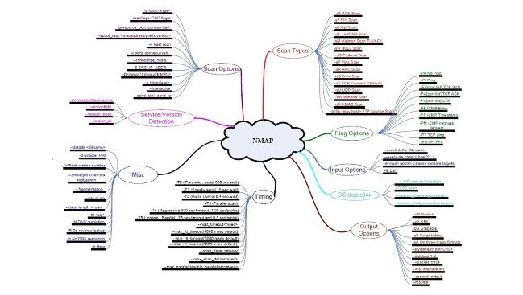
Modules Involved in the Project
1
Main Module (main.py)
The main module handles user interaction and orchestrates the execution of various scan operations within the system.
2
Scanner Module (scanner.py)
The scanner module is responsible for executing different types of scans and processing the results obtained from these scans.
3
README.md
This file provides a comprehensive overview of the project, including instructions on how to use the system and navigate its features.

Slide 8


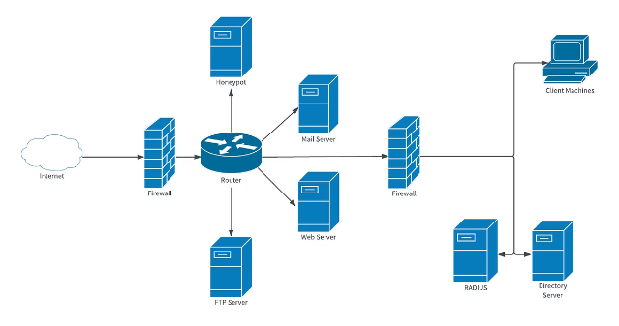

Architecture & Testing
Main Module
The main script (main.py) interacts with the user, gathers input, and triggers the appropriate scan functions from the scanner module.
Scanner Module
The scanner module (scanner.py) performs the requested scans using Nmap and processes the resulting data, providing detailed output to the user.

Slide 9

Output & Conclusion
Output
The system provides detailed information about hosts on the network, including their open ports, services running on those ports, and the operating systems they use.
Conclusion
This project successfully provides a user-friendly interface for network scanning, enhancing efficiency and accessibility for network administrators and security professionals.

